Slide 1


Group Utalk Presentation
Group 13

Slide 2
Introduction & Functionality
Kuang jiang

Slide 3
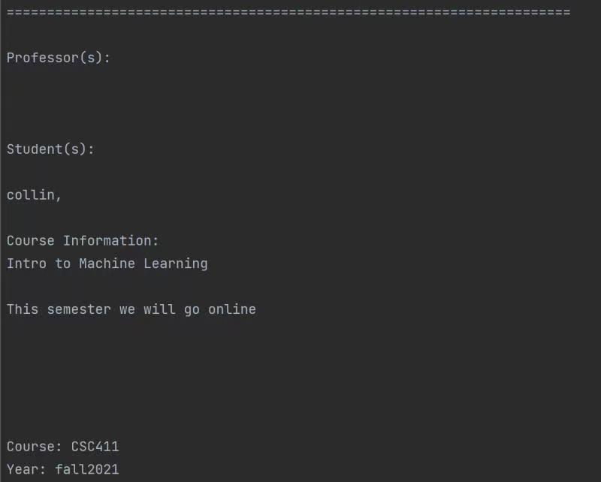
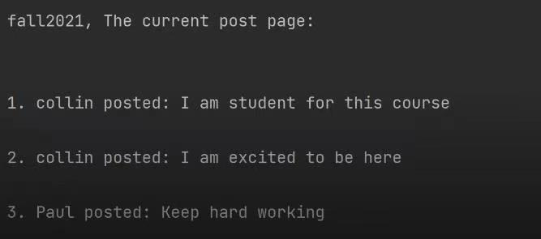
Introduction Utalk
Our group want to make a discussion forum based on course
Users:students, professors and faculties
Course page. Comment page

Slide 4
Functionality
Faculty: add course, update course
Student: add comment, delete one's own comment, enroll course, drop course, present course page, present postpage
Professor: add comment, delete comment(everyone’s comment under that postpage), enroll course, drop course, present course page, present postpage
-> demo video

Slide 5
Major Decisions
Zhijun Wang

Slide 6
Major decisions
Controller class for UIs
Packaging
Comment Data Structure
Commentable User
Notes:
To reach the current version of classes structures, we made the following decisions

Slide 7
Packaging & Class Diagram& Test
Hanqi Zhang

Slide 8
Packaging
•Edu
•Four layers + runner
•Functional ones (e.g., boundaries, createupdate)

Slide 9
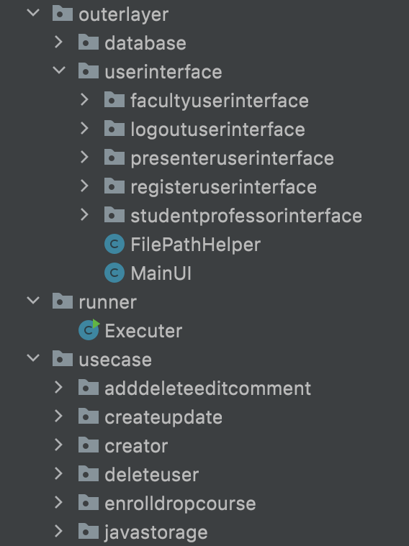
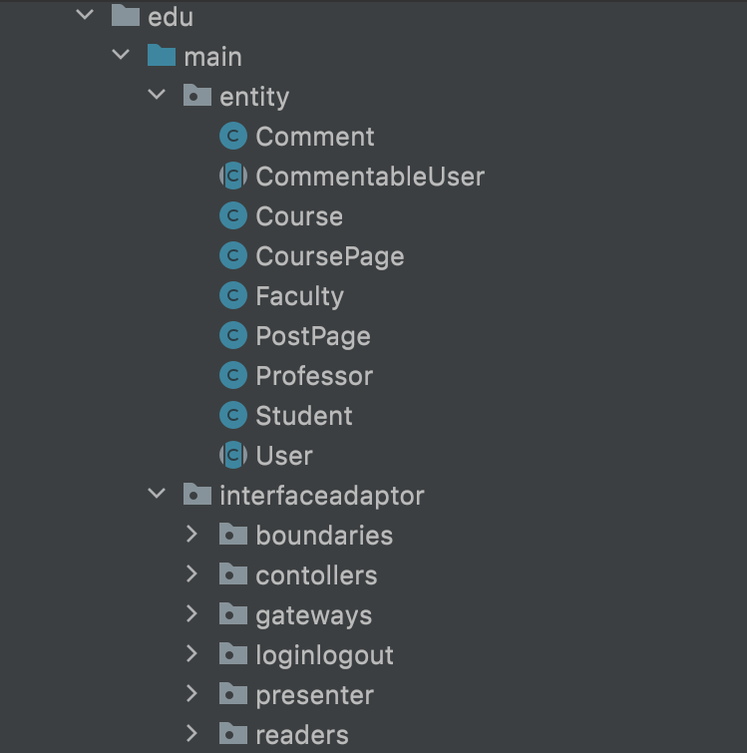

Slide 10
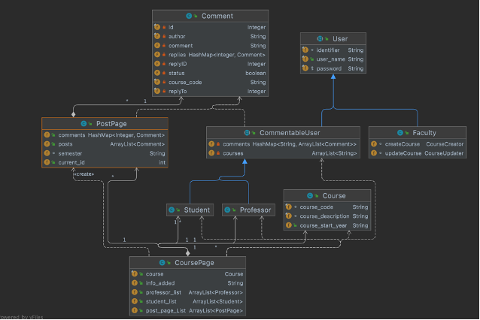
Class Diagram – Entity classes

Slide 11
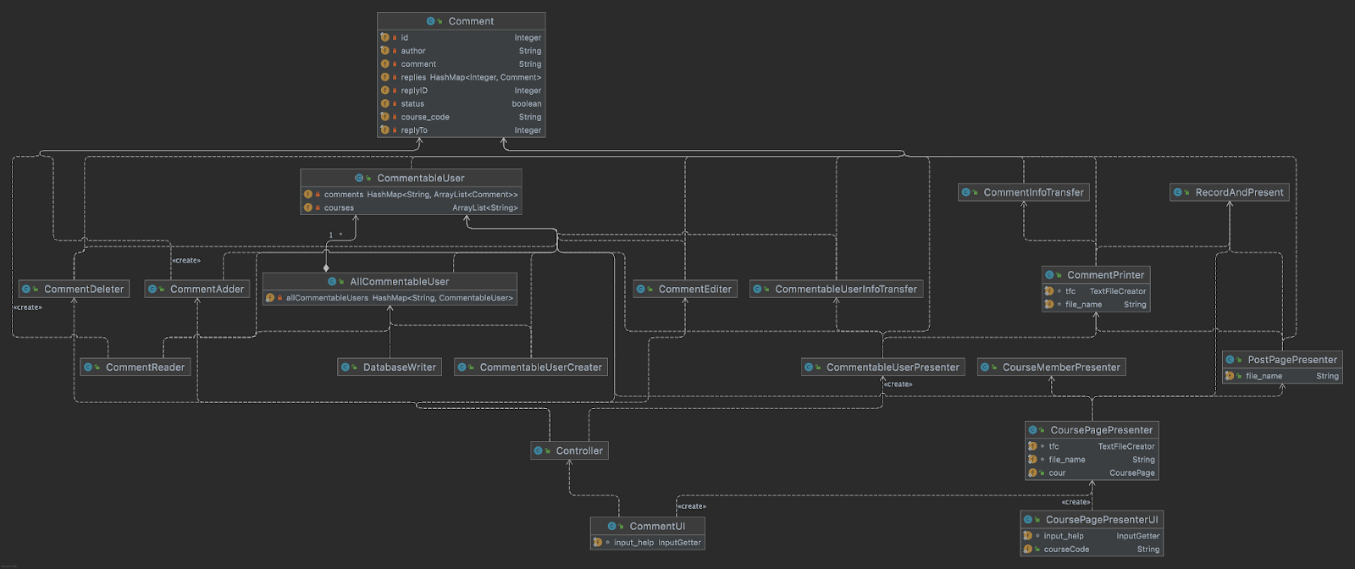
Class Diagram Comment & associated Methods

Slide 12
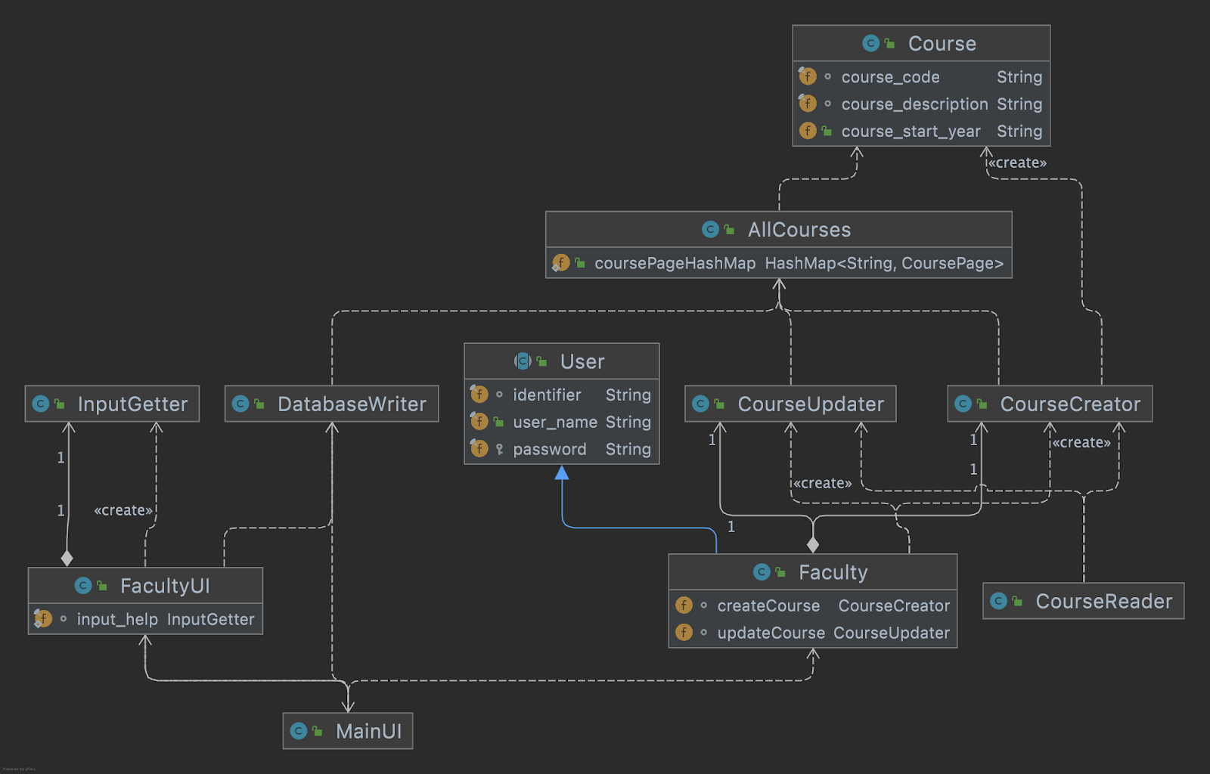
Class Diagram Faculty & associated Methods

Slide 13
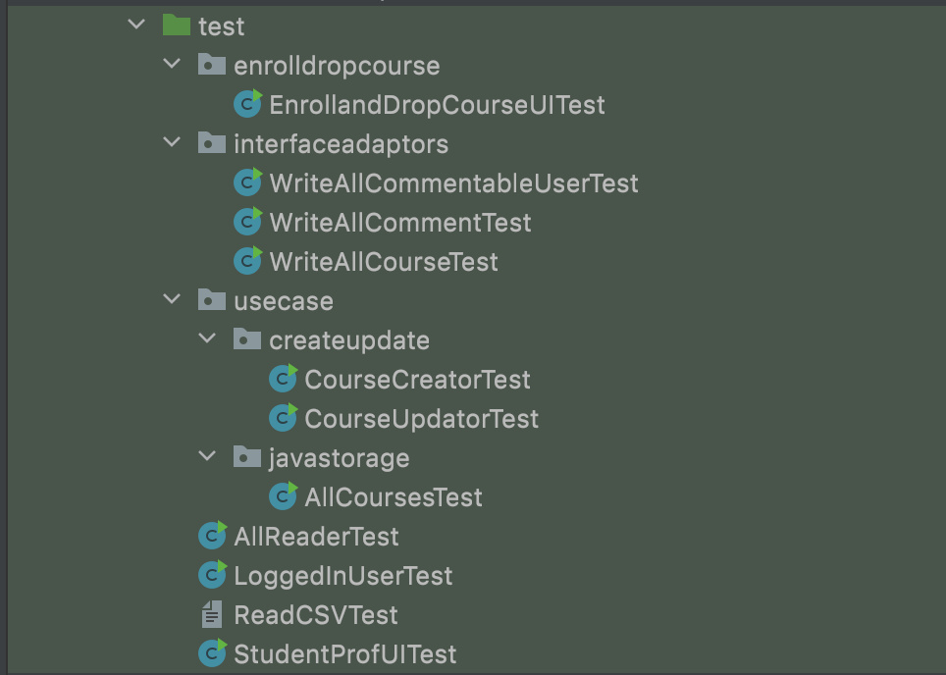
Test

Slide 14
Clean Architecture & Scenario walk-through
Zeyuan li

Slide 15
Clean Architecture
Four layers
entity
interfaceadapter
outlayer
usercase

Slide 16
Comment

Slide 17
Scenario walk-through
Explain how we login and enroll course.
Explain how we add comment

Slide 18
SOLID design principle
Chuanyang Qiao

Slide 19
Solid principle
single responsibility principle
open closed principle
Liskov substitution principle
interface segregation principle
dependency inversion principle

Slide 20
Design Pattern
Junhao Saw

Slide 21
Design Patterns
Template Design Pattern

Slide 22
Use of Github Features
Kuang Jiang

Slide 23
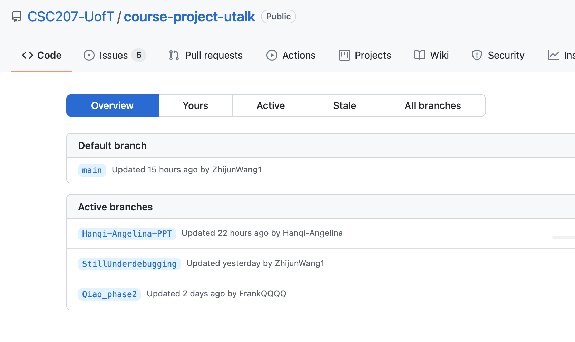
Use of Github Features
Branch
descriptive name
Closed after finished

Slide 24
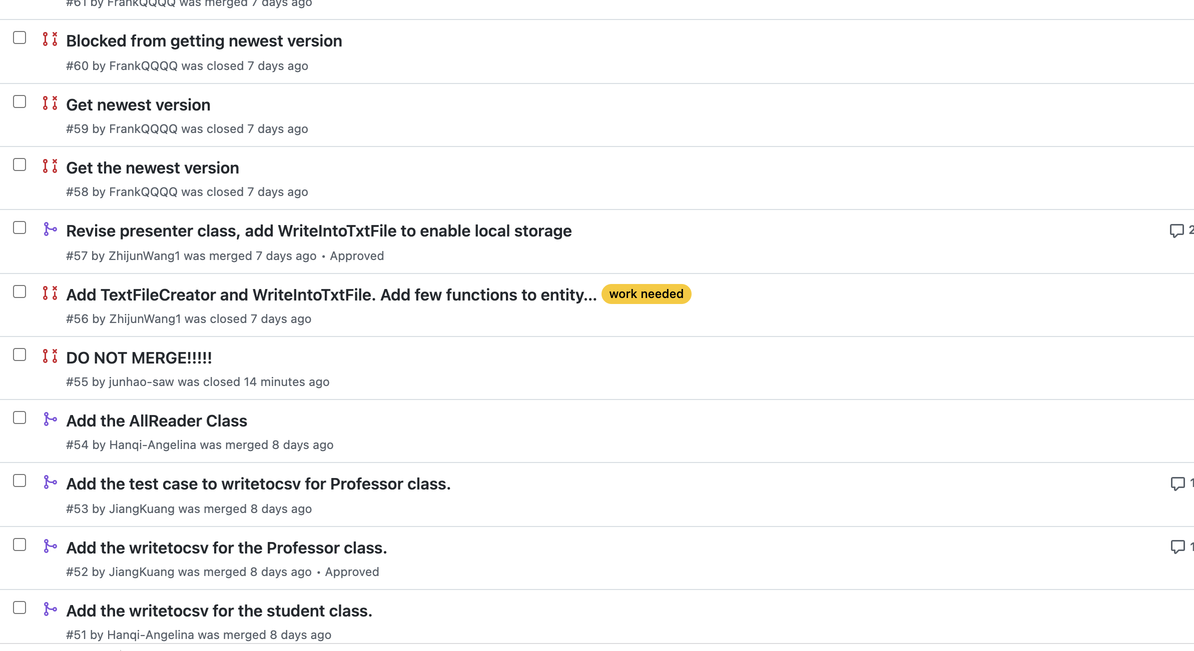
Use of Github Features
pull request
descriptive title
Teammate check

Slide 25
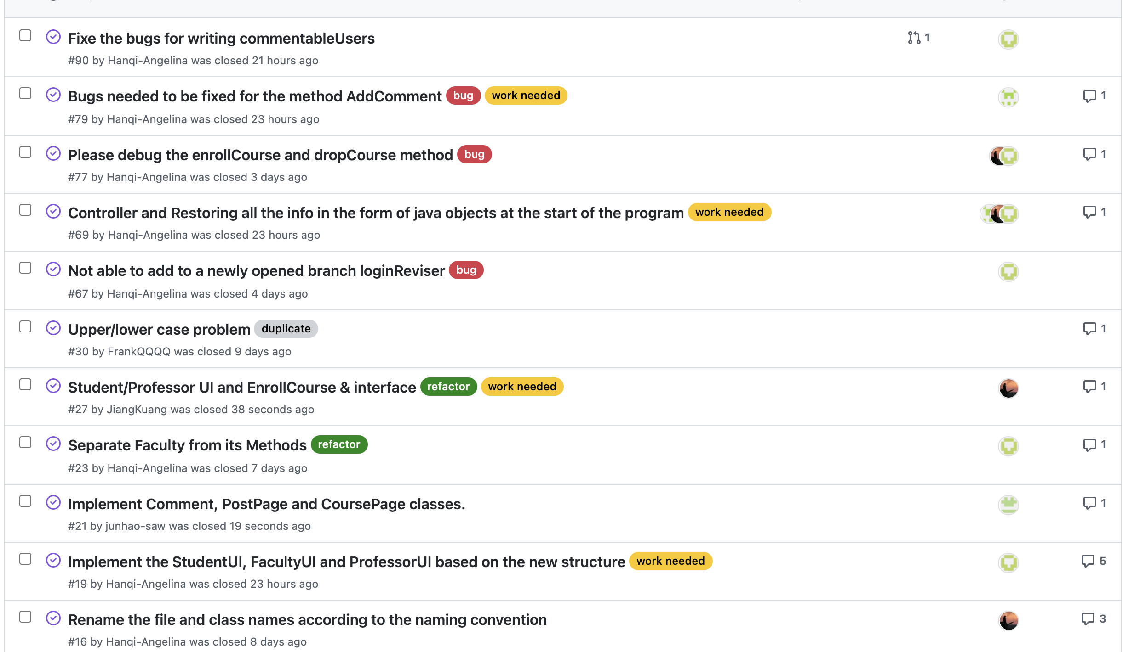
Use of Github Features
Issues
List issues
Group talk
Finish and close

Slide 26
Project Accessibility
Junhao Saw

Slide 27
Project Accessibility
Principle 1: Equitable Use
Principle 2: Flexibility in Use
Principle 3: Simple and Intuitive Use
Principle 4: Perceptible Information
Principle 5: Tolerance for Error
Principle 6: Low Physical Effort
Principle 7: Size and Space for Approach and Use

Slide 28
labour of devision
Hanqi Zhang: reader, writer, several link UI
Chuanyang Qiao: Register, log in, log out
Zeyan li : comment UI, Write and Read Comment
Junhao Saw: add, delete, edit comment
Zhijun Wang: presenter, presenter UI
Kuang Jiang: Course Enroll and Drop, UI

Slide 29
For Phase 2
We redesign the packaging
Add controller
Add new entity commendable user
Finish all the Functionalities
But there still some bugs we need to fix

Slide 30
Thanks!

